Slide 1
Summary of Validation of Non-Directional Stress Model with respect to iPack19 Paper
Trinity Cheng
07-27-10
Notes:
A slide or two that shows the stress values from the paper, the stress values you computed (from the bottom layer of the device) and the % difference between them. Also the same for temperatures since the Stress are directly related to the temps.

Slide 2
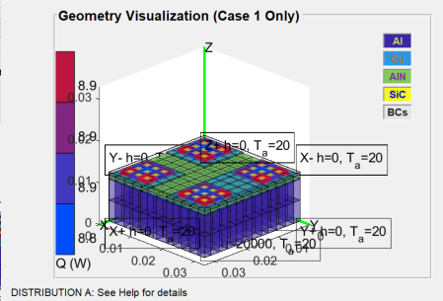
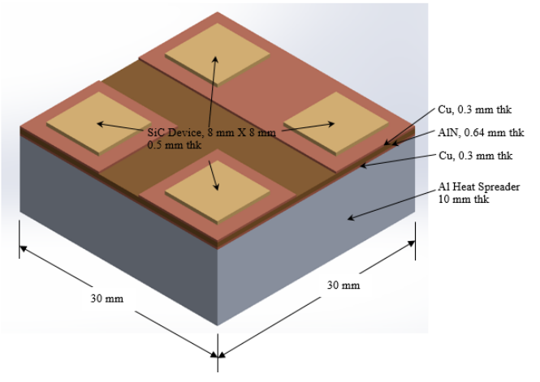
Validation Workflow
Construct planar geometry as described in iPACK17 (ipackmodel.ppresults)
Run solver for temperature and melt fraction values
Save PPResults object in GUI
ParaPowerGUI(‘GetResults’).R
Use PPResults object as input for NonDirectional to get exact Von Mises stress values
iPACK17[1]
NonDirectional

Slide 3
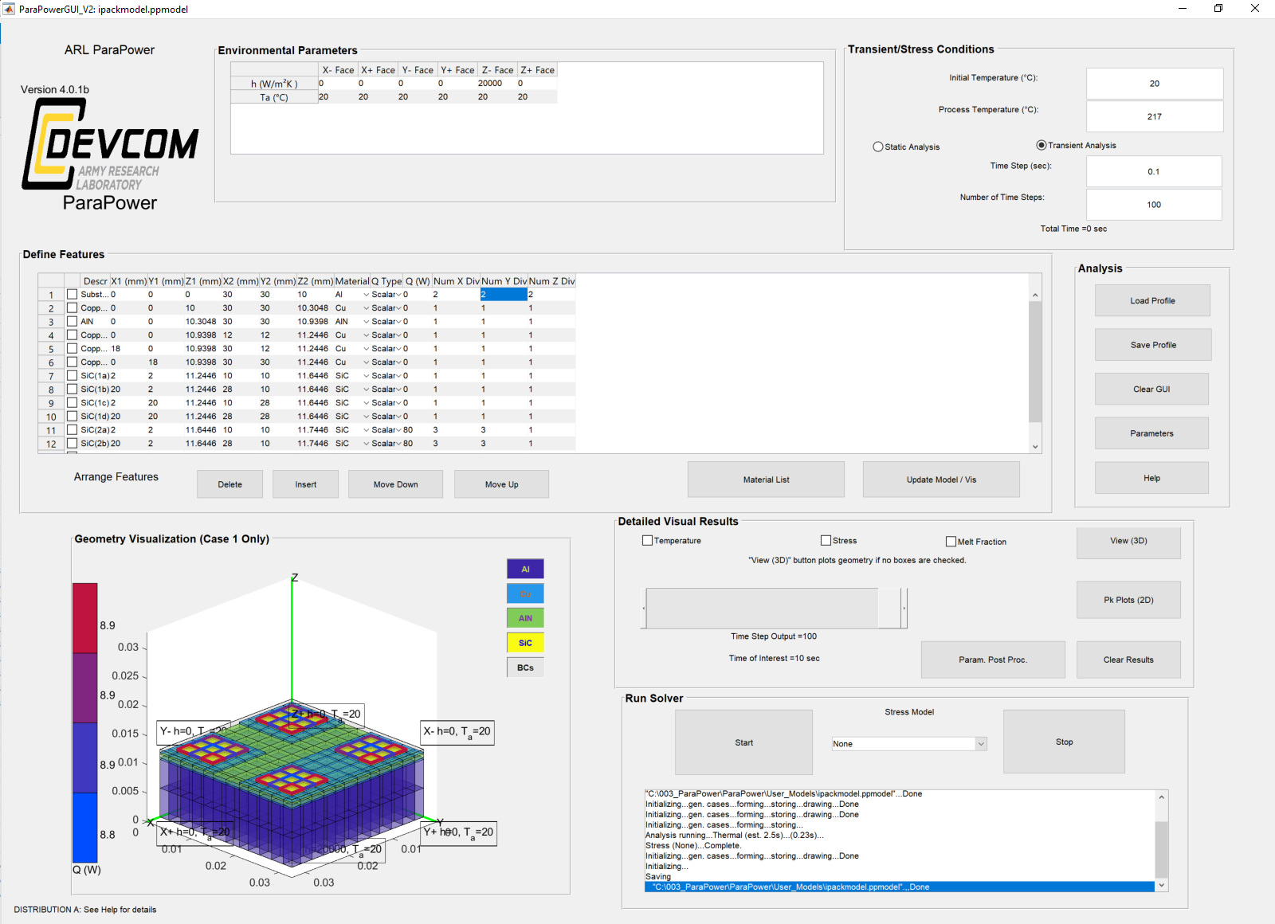
Parameters used in GUI

Slide 4
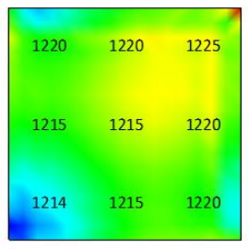
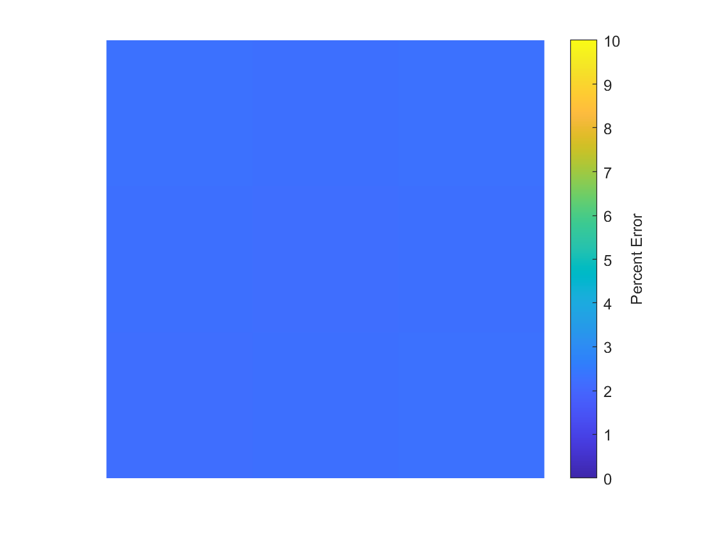
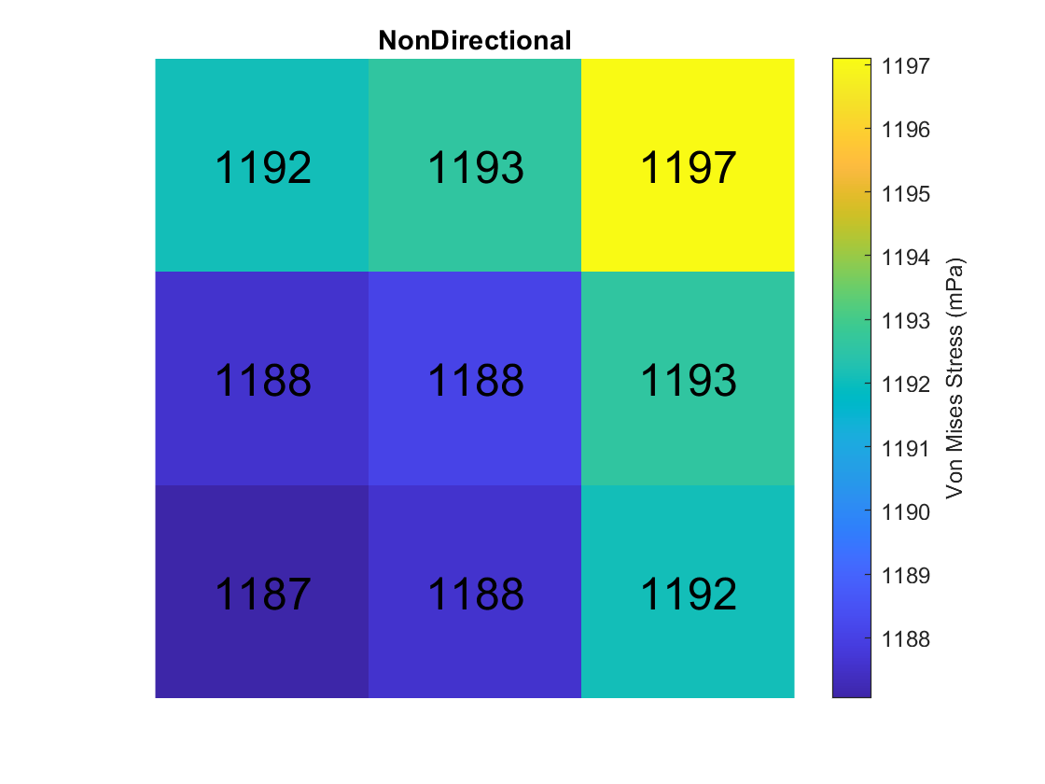
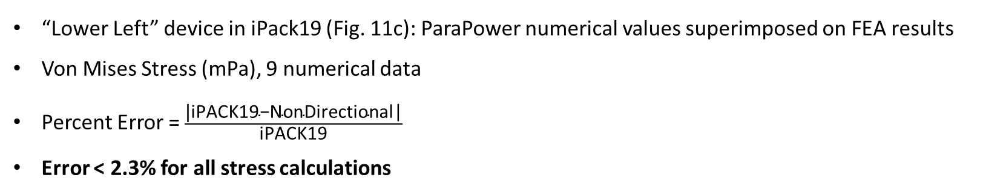
Stress Comparison
“Lower Left” device in iPack19 (Fig. 11c): ParaPower numerical values superimposed on FEA results
Von Mises Stress (mPa), 9 numerical data
Percent Error = $\frac{\text{|}\text{iP}\text{ACK}\text{19−}\text{NonDirectional}\text{|}}{\text{iP}\text{ACK}\text{19}}$
Error < 2.3% for all stress calculations
iPACK19 [2]
NonDirectional
Percent Error

Slide 5
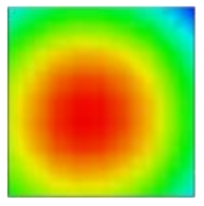
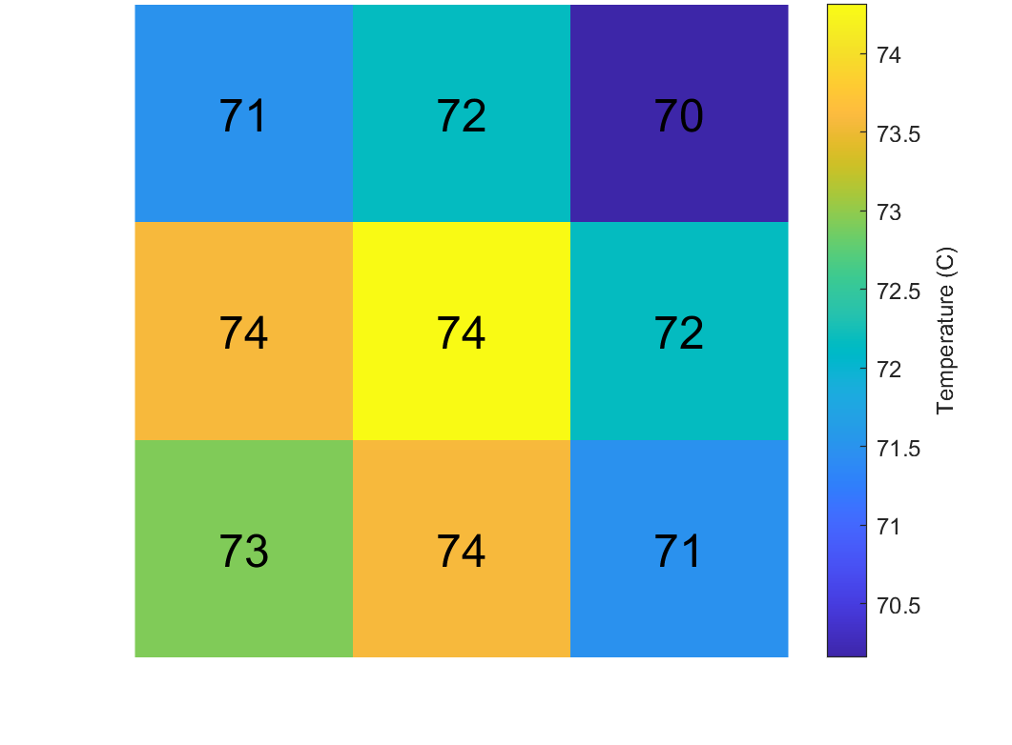
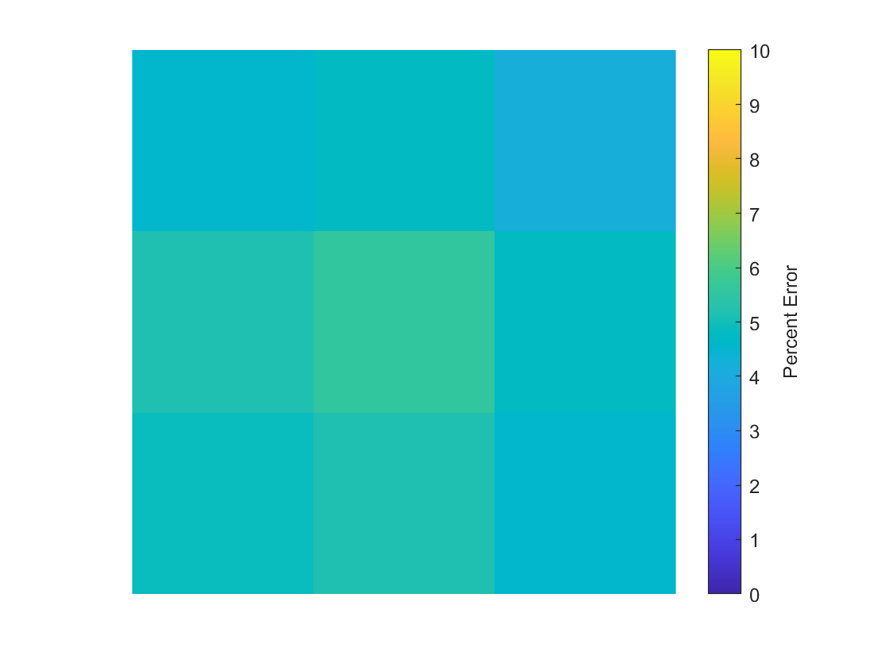
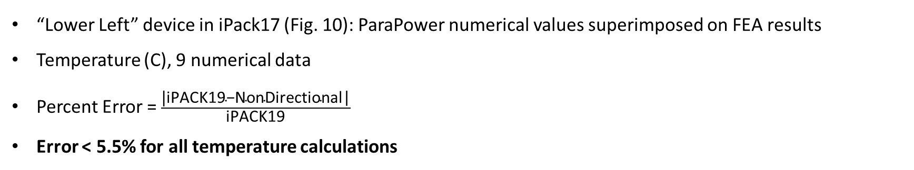
Temperature Comparison (C)
“Lower Left” device in iPack17 (Fig. 10): ParaPower numerical values superimposed on FEA results
Temperature (C), 9 numerical data
Percent Error = $\frac{\text{|}\text{iPACK}\text{19−}\text{NonDirectional}\text{|}}{\text{iPACK}\text{19}}$
Error < 5.5% for all temperature calculations
iPACK17 [1]
NonDirectional
Percent Error
74.9 | 75.8 | 73.2
77.6 | 78.7 | 75.8
76.7 | 77.6 | 74.9

Slide 6
References
[1] Boteler, L. M., and Miner, S. M. "Power Packaging Thermal and Stress Model for Quick Parametric Analyses." Proceedings of the ASME 2017 International Technical Conference and Exhibition on Packaging and Integration of Electronic and Photonic Microsystems collocated with the ASME 2017 Conference on Information Storage and Processing Systems. ASME 2017 International Technical Conference and Exhibition on Packaging and Integration of Electronic and Photonic Microsystems. San Francisco, California, USA. August 29–September 1, 2017. V001T04A012. ASME. https://doi.org/10.1115/IPACK2017-74130
[2] Boteler, L. M., and Miner, S. M. "Evaluation of Low Order Stress Models for Use in Co-Design Analysis of Electronics Packaging." Proceedings of the ASME 2019 International Technical Conference and Exhibition on Packaging and Integration of Electronic and Photonic Microsystems. ASME 2019 International Technical Conference and Exhibition on Packaging and Integration of Electronic and Photonic Microsystems. Anaheim, California, USA. October 7–9, 2019. V001T06A003. ASME. https://doi.org/10.1115/IPACK2019-6381

